Slide 1
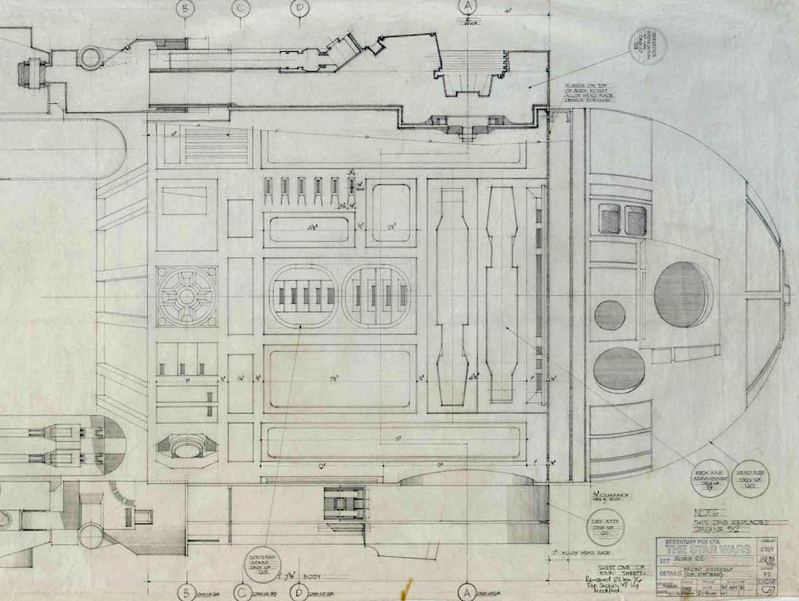
nat5 GRAPHIC COMMUNICATION
Drawing Standards, Conventions and Symbols

Slide 2
THEORY JOTTER
FRONT COVER:
  Full Name
  Nat5 Graphics Theory Notes
  Mr. Porter
FIRST PAGE
  Write the title: “CONTENTS”
NUMBER EVERY PAGE AT THE BOTTOM OUTSIDE CORNER
  Contents should be page 1
ON THE CONTENTS PAGE:
Put a number “1” and Write down the topic: “Drawing Standards, Conventions and Symbols”
ON THE SECOND PAGE
Write down the topic: “Drawing Standards, Conventions and Symbols”

Slide 3


Learning intentions & success criteria
Learning Intentions
Developing my understanding of drawing standards and conventions
Success Criteria
Understand and recognise the different line types and symbols
Analyse a technical drawing and understand it

Slide 4
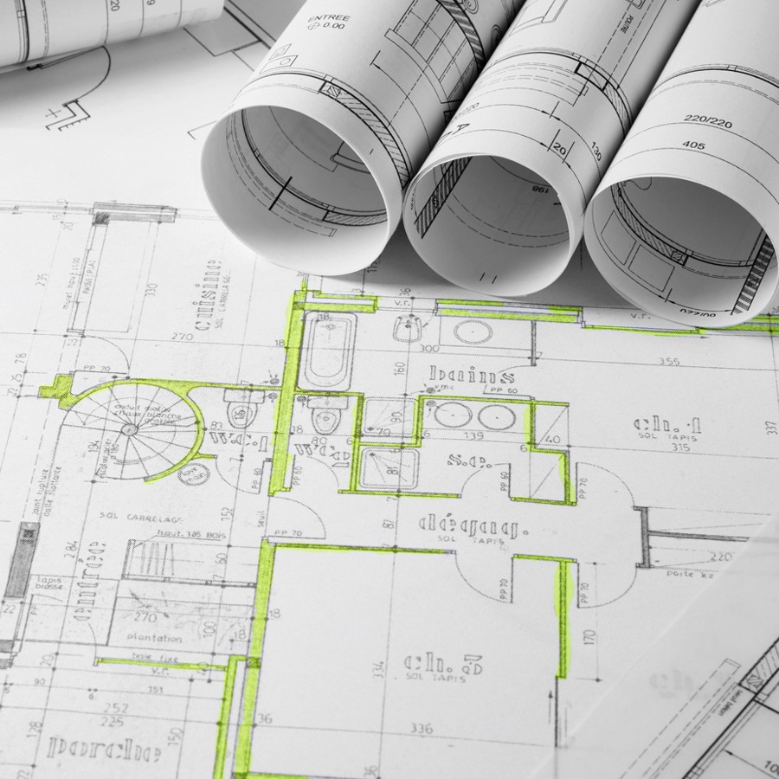
introduction
Symbols and conventions are used in order to simplify the drawing process.
They make drawings simpler and quicker to produce and easier to understand.
They ensure standardisation.

Slide 5

standardisation
Ensures that no matter who uses them across the globe, they can be understood by everyone.

Slide 6

benefits
Drawings are simplified because symbols are used
Drawings are quicker to produce
Common standards so all users have accessibility
A consistent drawing layout and set of symbols is established
Language barriers are eliminated

Slide 7

who uses technical drawings?
People who produce drawings:
  Architects
  Designers
  Draughtsmen/women
People who read and work from drawings:
  Engineers
  Builders
  Electricians
  Joiners
  Manufacturers

Slide 8

British standard
Drawing symbols used in Britain are standardised by the British Standards Institution (BSI).
The BS 8888 publication sets British and international drawing standards and provides a common language that can be understood worldwide.

Slide 9
Drawing symbols
The most common drawing conventions and symbols will be shown in the next few slides.
You will use them in your coursework drawings.
It is important to understand and remember them.
Study their use in any design drawings you work on.
A common exam type question will ask you to identify incorrect or missing symbols on a drawing.

Slide 10
  Visible Outlines
  Construction/Projection
  Hidden Detail
  Centre Line
  Fold Line
  Cutting Plane
A
A
  Cross-Hatching 45°

Slide 11
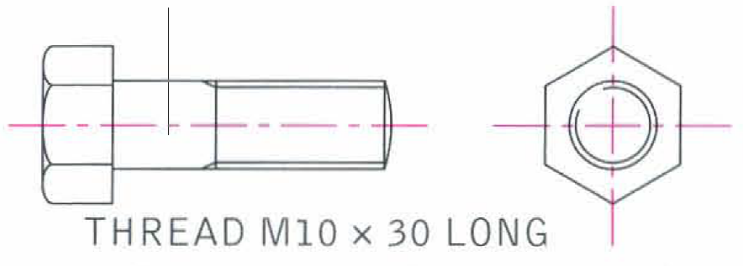
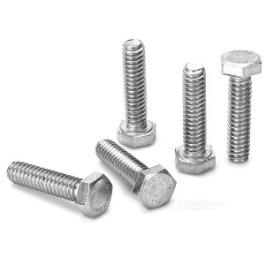
Screw threads
Screw Threads are shown as double lines.
Broken inside circle is an external screw thread.
Here the screw is of diameter 10mm with a length of thread 30mm.

Slide 12
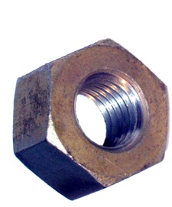
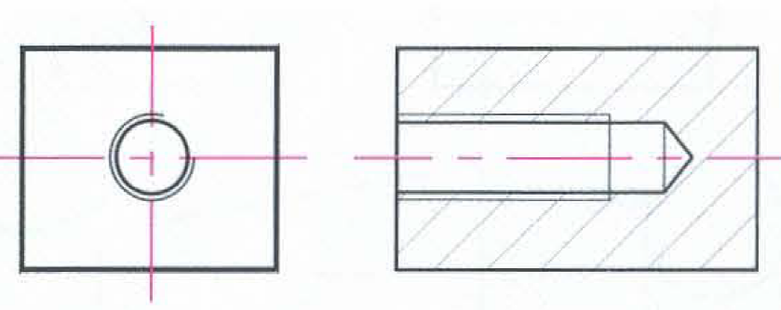
Screw threads
The internal screw thread shown here as double lines.
Note how the outside circle is broken on the end view.

Slide 13

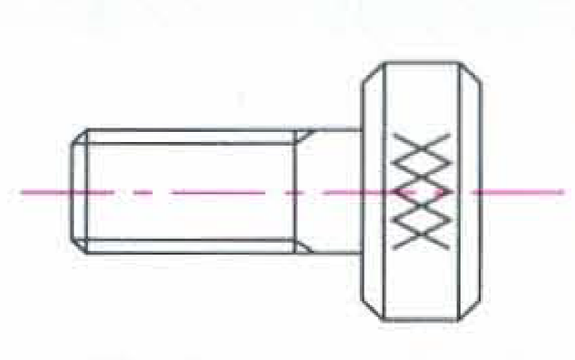
knurling
Knurling indicates where a criss-cross pattern is required on a surface to provide better grip.

Slide 14
Drawing symbols
  ⌀
  ⌀
  Diameter e.g. ⌀60
  R
  Radius e.g. R30
  R
  Square section e.g. 40
  A/F, A/C
  ‘Across Flats’ or ‘Across Corners’
  PRT
  Definition for a Part
  ASSY
  Definition for an Assembly

Slide 15
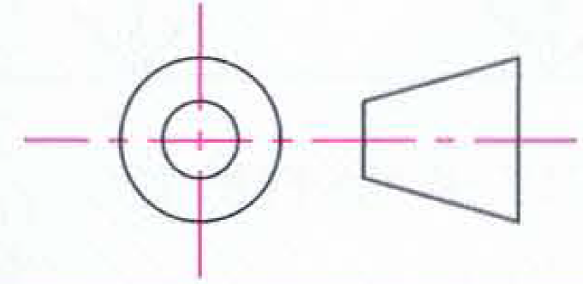
Third angle projection symbol
Third Angle Projection Symbol
This is added to diagrams to help explain their layout

Slide 16
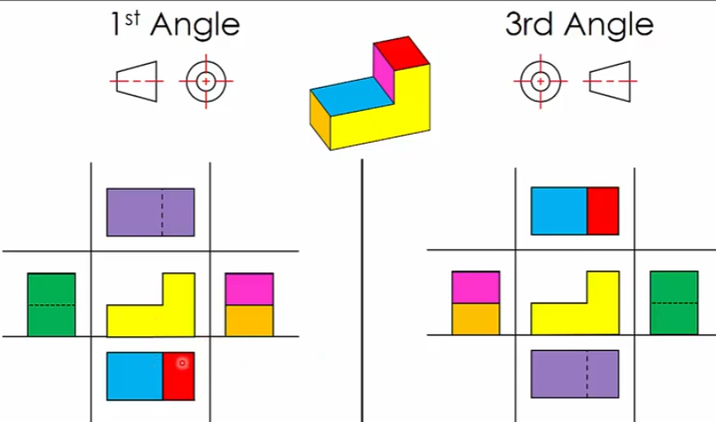
First angle vs third angle projection

Slide 17
dimensioning
Dimensions (measurements) are essential on most productions drawings because they enable the reader to manufacture and construct products etc. accurately.
The dimensioning system we use is again BS 8888.
You are required to show dimensions on drawings in your unit tasks and coursework!

Slide 18
dimensioning
We will be looking at the following dimension types.
  You must know these:
  Parallel
  Chain
And you must know how to add dimensions to:
  Lines
  Circles
  Angles
  Curves/Arcs

Slide 19
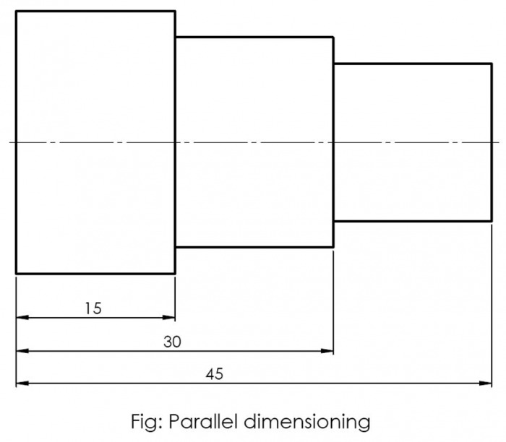
parallel

Slide 20
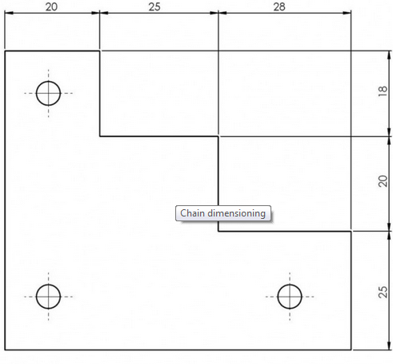
chain

Slide 21
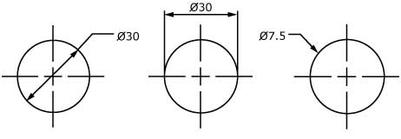
circle
Always use the ⌀ symbol when it is a FULL CIRCLE

Slide 22
arc
Only use the R symbol to donate an arc or curve.
Must point arrow to the centre of the arc or curve.
R15

Slide 23
angle
63˚

Slide 24
ORTHOgraphic vs pictorial
ORTHOGRAPHIC drawing (or projection) means 2D drawings.
These are typically production drawings showing different 2D views of a 3D object.
They would include vital information such as dimensions.
PICTORIAL drawings are a 3D representation of an object.
These offer an easily understood projection of an object, particularly to those who do not understand orthographic projections.
There are various different types of pictorial drawing you must learn.

Slide 25
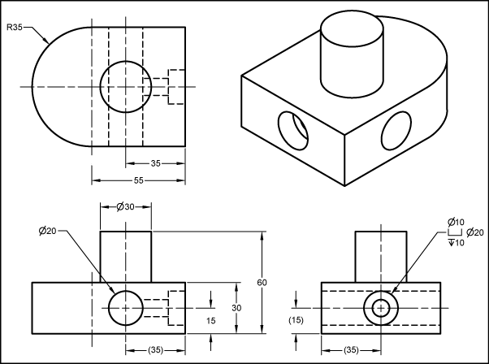
Drawing types
There are 2 main drawing types
  Orthographic
  Pictorial

Slide 26
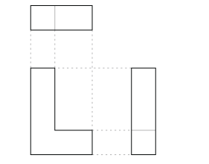
orthographic
Orthographic 2D drawings
  3 Views:
    Elevation
    End Elevation
    Plan
Other Views we will study later on:
  Section (S3)
  True Shape (S4)
  Surface Development (S4)
Plan
Elevation
End Elevation

Slide 27
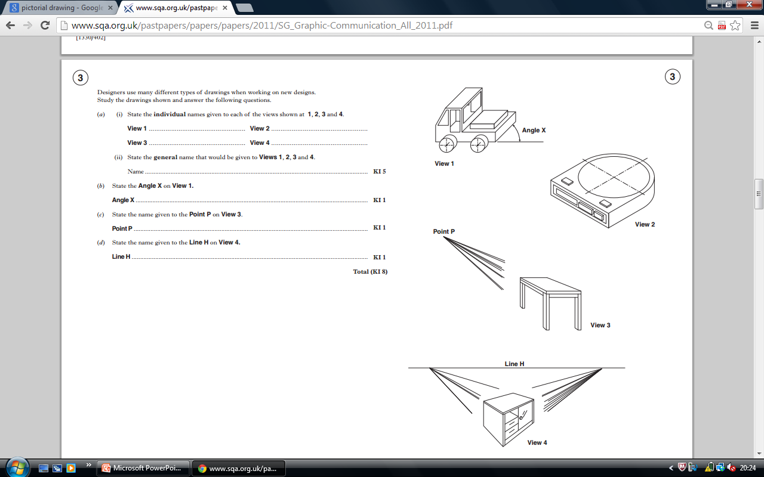
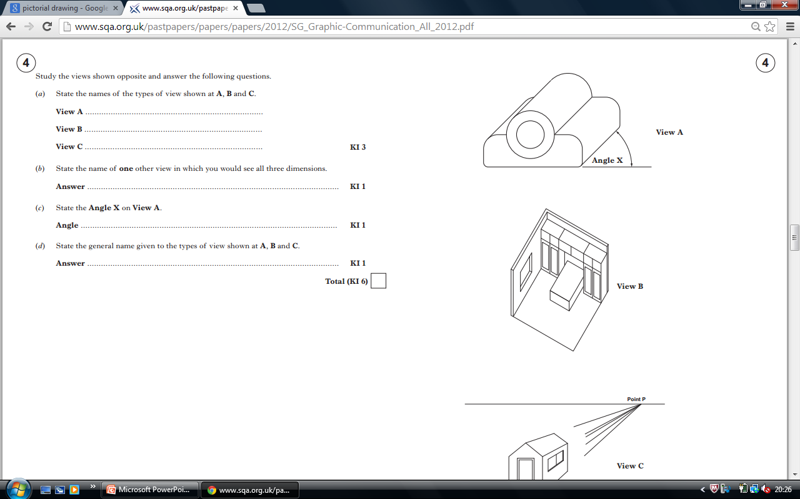
pictorial
Pictorial 3D Drawings
  1 Point Perspective
  2 Point Perspective
  Planometric
  Oblique
  Isometric
Oblique
Isometric
1 PT Perspective
2 PT Perspective
Planometric

Slide 28
perspective
1 Point Perspective
2 Point Perspective
Notes:
  Horizon Line
  Vanishing Points

Slide 29
isometric
Vertical lines remained vertical.
All other lines drawn at 30°

Slide 30
planometric
Base is a true plan, rotated.
Drawn at 45º/45º
OR Drawn at 30º/60º
Used for internal view of a room/area.

Slide 31
oblique
Draw a 2D elevation
Depth projected at 45º
Measure half the distance back.
Can see true size of a circle.

Slide 32
Dimensioning rules
Each dimension should only be shown once
Show your dimensions in millimetres (mm)
Place the dimensions on the drawings so they can be read either:
From the bottom
The left-hand side
Figures should NOT touch outlines, dimensions lines or centre lines
⌀ before a dimension denotes the diameter of a circle
R before a dimension denotes the radius
On circles, always dimensions the diameter, never the radius
On curves, arcs and rounded corners, always show the radius

Slide 33
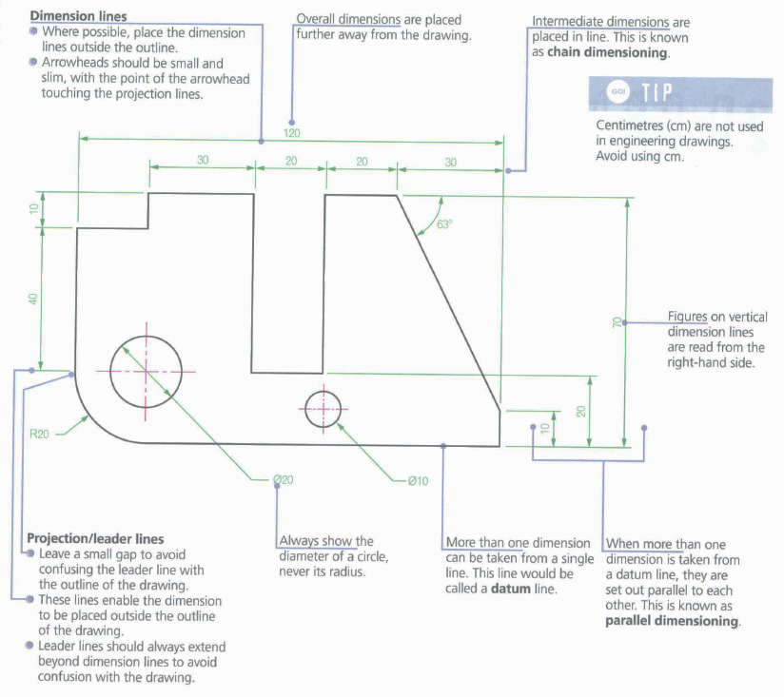
TASK: Replicate the above drawing and include dimensions.

Slide 34
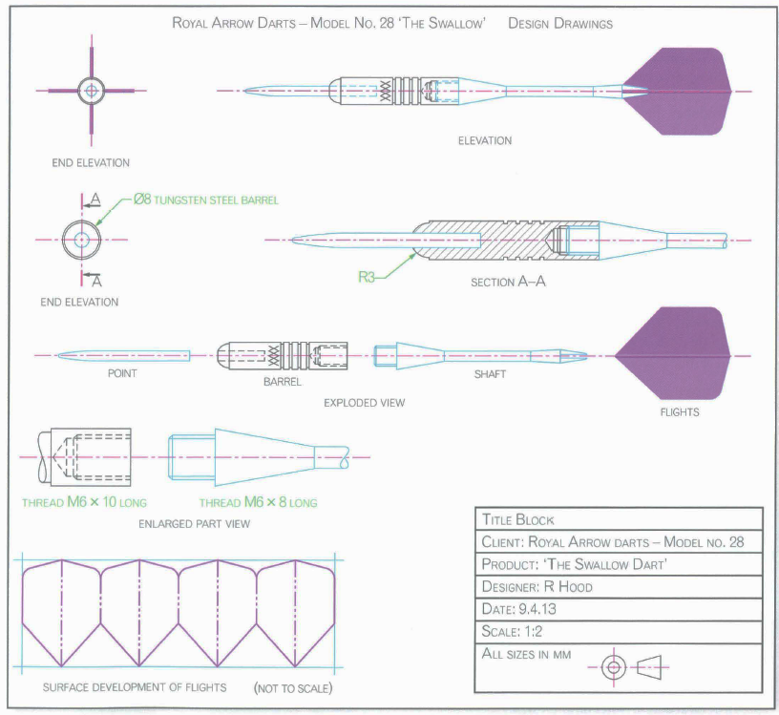
  Turn to p20 in the
  National 4 & 5
  Graphic Communication
  Course Notes Book
  Answer the Question 1 and 2 in your jotter.

Slide 35
Activity 2
  Continue your Inventor Production Drawings by adding the following to your drawings:
  The correct symbols
  The correct dimension styles (chain, circle etc).
  Check off the production drawings list as you go.
  Refer to your notes.

